Slide 1
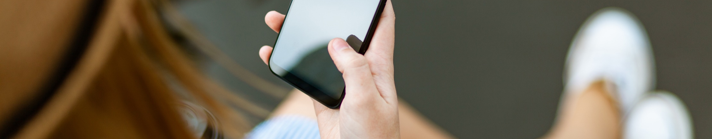
Simple Touch Prediction With Built-In IMUs
Felix Bühler, Benedict Steuerlein
FaPra Machine Learning and Computer Vision for HCI | Pfaffenwaldring 5a | 05.02.19

Slide 2

Smartphone sizes are increasing steadily.
Whole front screen can not be reached
without changing the grip.
Predict where users want to touch.
https://www.pexels.com/photo/person-holding-smartphone-white-sitting-1310532/

Slide 3
Smartphone sizes are increasing steadily.
Whole front screen can not be reached
without changing the grip.
Predict where users want to touch.
Preload content based on future touch.
Enhance content for further information gathering.

Slide 4
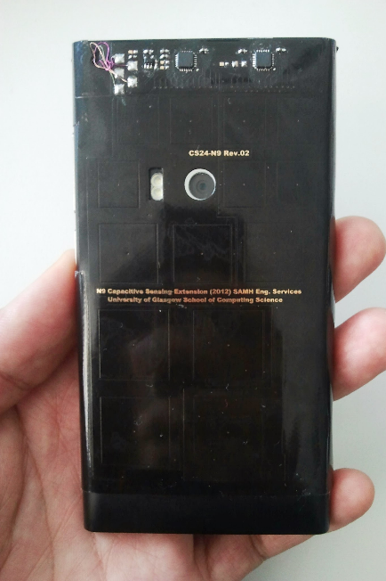
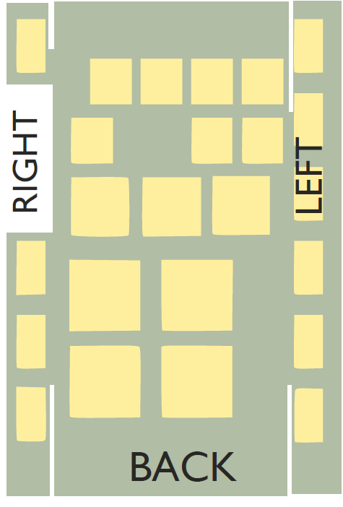
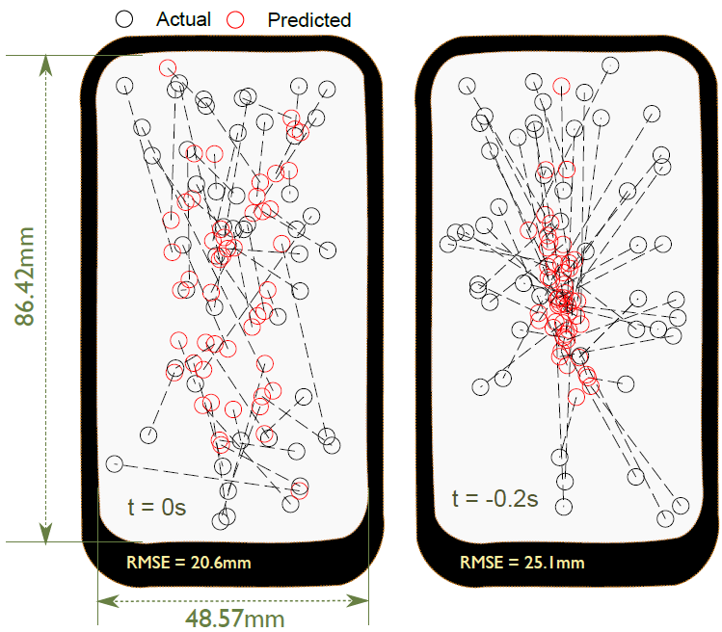
28 Frames Later Predicting Screen Touches From Back-of-Device Grip Changes
Analyze grip change with 24 sensors on the phones‘ laterals and back side
Predict future touch positions
Achievement of an accuracy of 18 mm and predicting touches 200ms in the future
Faizuddin, M., Noor, M., Ramsay, A., Hughes, S., Rogers, S., Williamson, J., & Murray-smith, R. (2014). 28 Frames Later : Predicting Screen Touches From Back-of-Device Grip Changes. Proceedings of the SIGCHI Conference on Human Factors in Computing Systems, 2005–2008. https://doi.org/10.1145/2556288.2557148

Slide 5
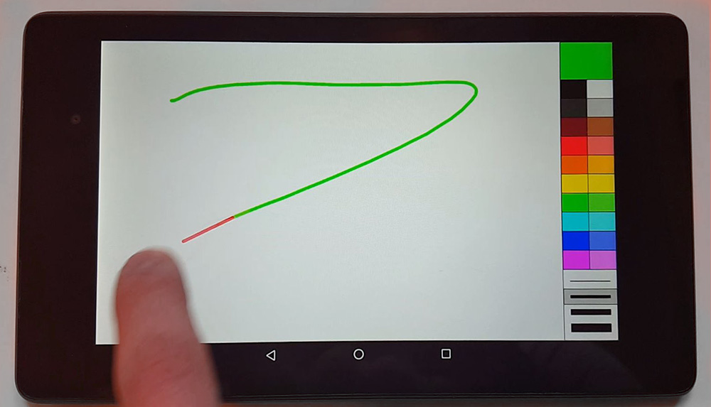
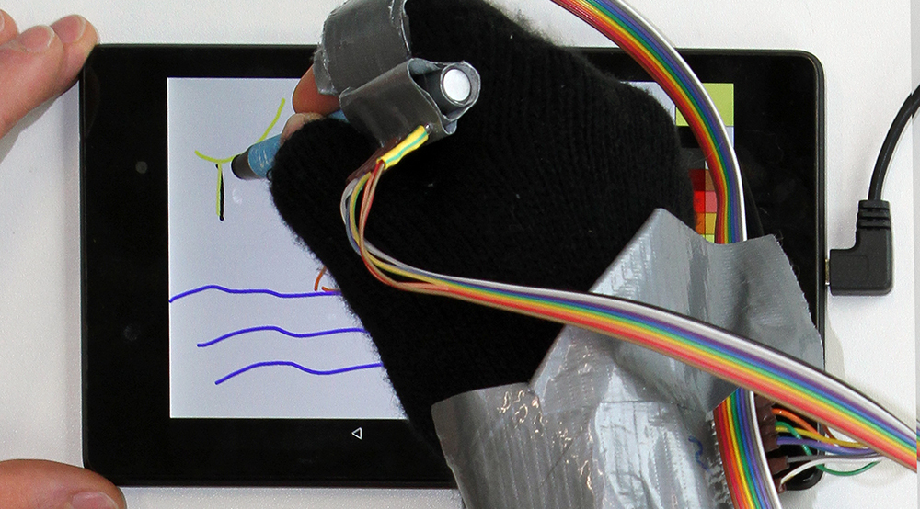
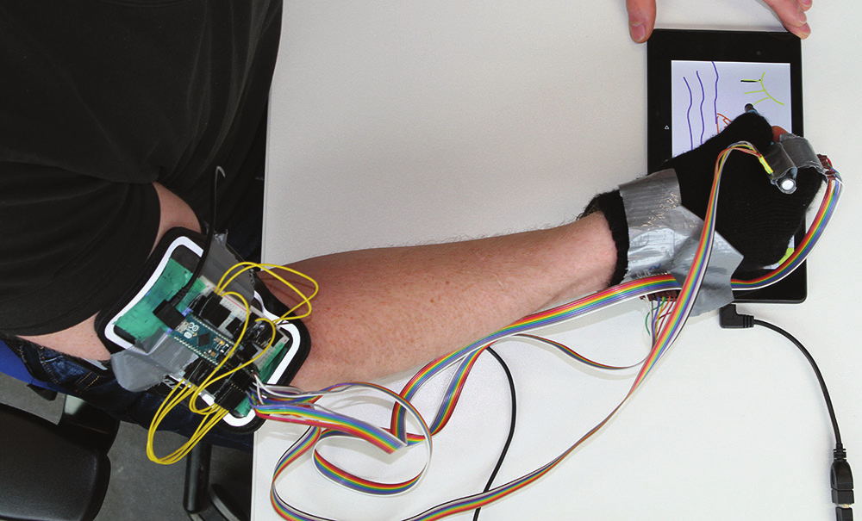
PredicTouch Reducing Touchscreen Latency using Neural Nets
Reduce perceivable touchscreen latency by predicting future positions on touchscreen
Neural network combines IMU data with touch trajectories to predict future trajectories
Predicting 66ms into the future increases users’ throughput by 15% and 17% for finger and stylus
Le, H. V., Schwind, V., Göttlich, P., & Henze, N. (2017). PredicTouch. In Proceedings of the Interactive Surfaces and Spaces on ZZZ - ISS ’17 (pp. 230–239). https://doi.org/10.1145/3132272.3134138

Slide 6
New Approach
Use IMU data to predict future touches.
IMUs are better suited for ordinary usage
than additional sensors.
Suitability in natural environments.
Drive development for accuracy.

Slide 7
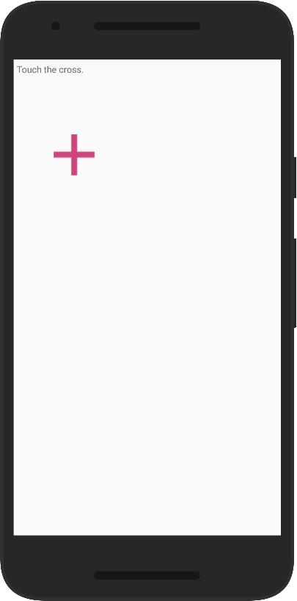
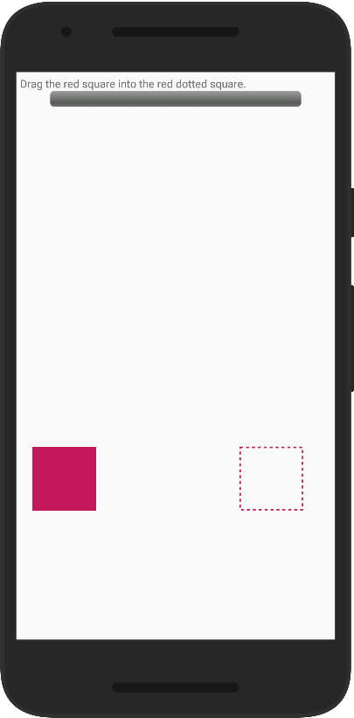
Design
Repeated-measures design
1 independent variable: PHONE
Amount of conditions = 4
Performing Study

Slide 8
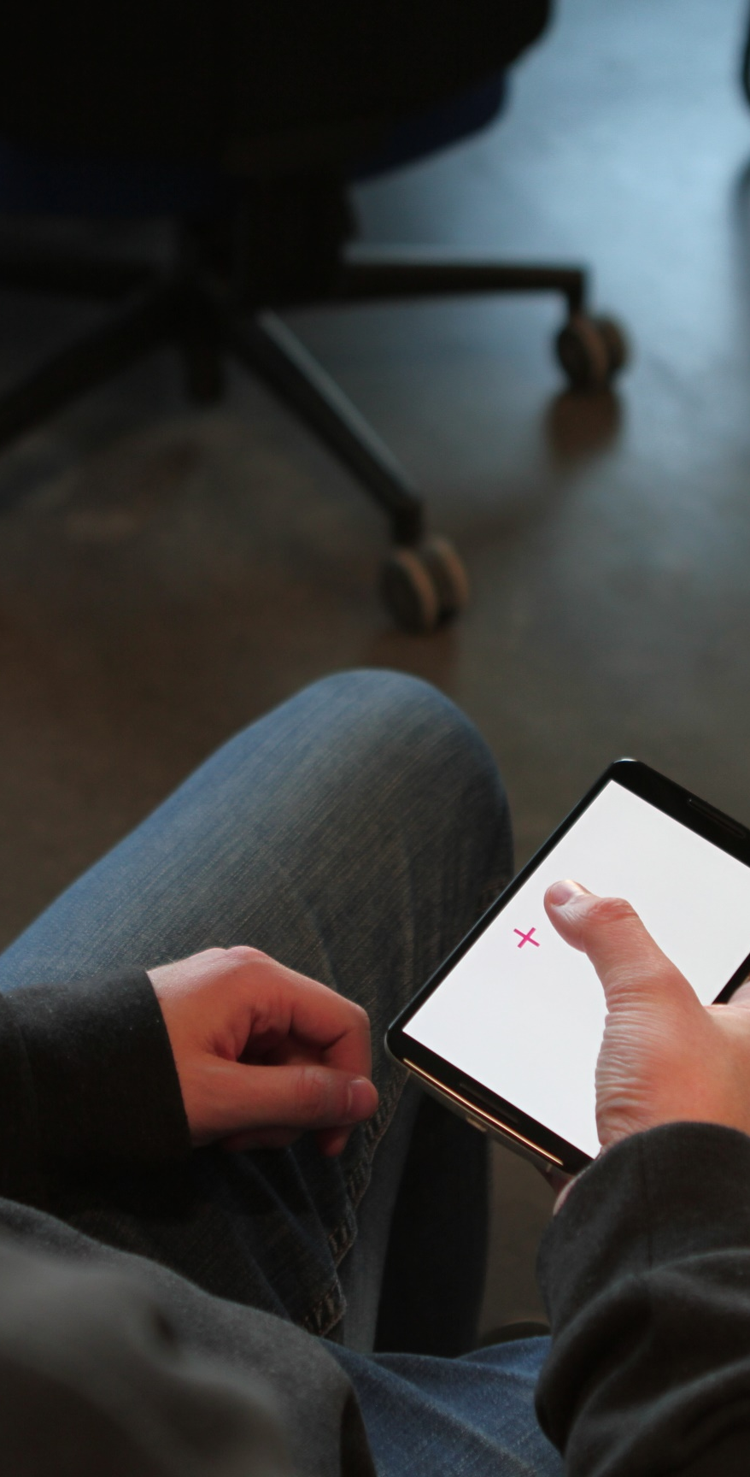
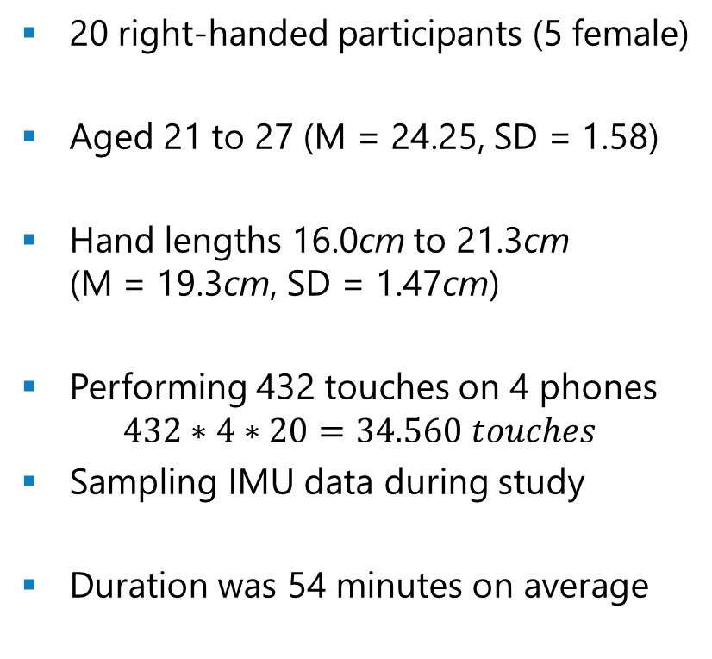
Study
20 right-handed participants (5 female)
Aged 21 to 27 (M = 24.25, SD = 1.58)
Hand lengths 16.0cm to 21.3cm (M = 19.3cm, SD = 1.47cm)
Performing 432 touches on 4 phones $432∗4∗20=34.560 touches$
Sampling IMU data during study
Duration was 54 minutes on average

Slide 9
Preprocessing
Raw data
Remove duplicates
Resample to 1 sample/3ms
Create intervals with 100 samples before touch
Export dataframe with sensor and touch data

Slide 10
Baseline – Euclidean Distance
Regressor | Random Forest | DecisionTree | KNeighbors | MLP
General (%) | 0.382 | 0.381 | 0.394 | 0.41
S3 Mini | 28.11mm | 28.81mm | 28.67mm | 30.13mm
S4 | 34.65mm | 35.58mm | 34.61mm | 36.55mm
Nexus 5X | 36.22mm | 37.03mm | 36.36mm | 38.72 mm
Nexus 6 | 41.27mm | 42.55mm | 42.91mm | 45.29mm

Slide 11
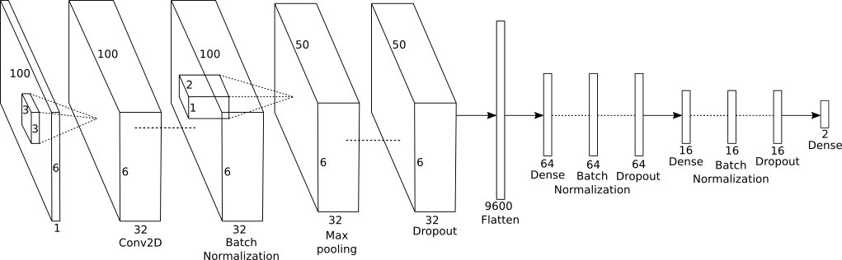
Model Structure

Slide 12
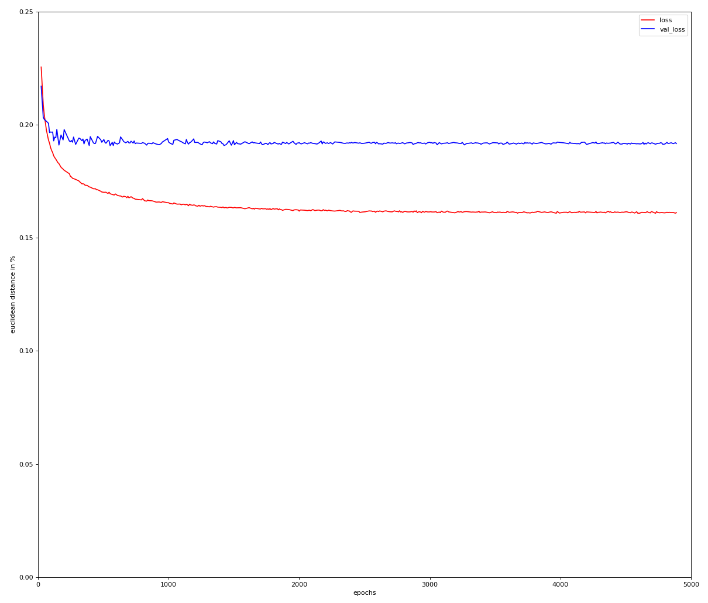
General Model Training

Slide 13
Model Predictions
S3 Mini
Nexus 6

Slide 14
Model Predictions
General Model
Single Models

Slide 15
Cross Validation
Phone Metric(mm) | S3 Mini | S4 | Nexus 5X | Nexus 6
Euclidean Distance | 12.56 (6.79) | 15.77 (9.18) | 16.94 (9.52) | 16.98 (10.56)
RMSE | 8.88 (4.8) | 11.15 (6.49) | 11.98 (6.73) | 12.01 (7.47)
X-Error | 1.64 (8.9) | 1.47 (10.57) | 1.81 (11.76) | 2.23 (10.72)
Y-Error | 2.58 (10.53) | 3.36 (14.09) | 3.94 (14.54) | 3.73 (16.1)

Slide 16
Conclusion
Training a model on sensor values from all phones results in good values.
However training models on a single phones‘ sensor values results in slightly better values.
Reducing the feature space to only accelerometer and gyroscope values produces better results.

Slide 17
Future Work
Generate a bigger dataset
Long term study over one week with about 10 participants
Record all sensor values while screen is unlocked
Record all touches
Create interaction methods
Measure throughput with and without touch predicition

Slide 18
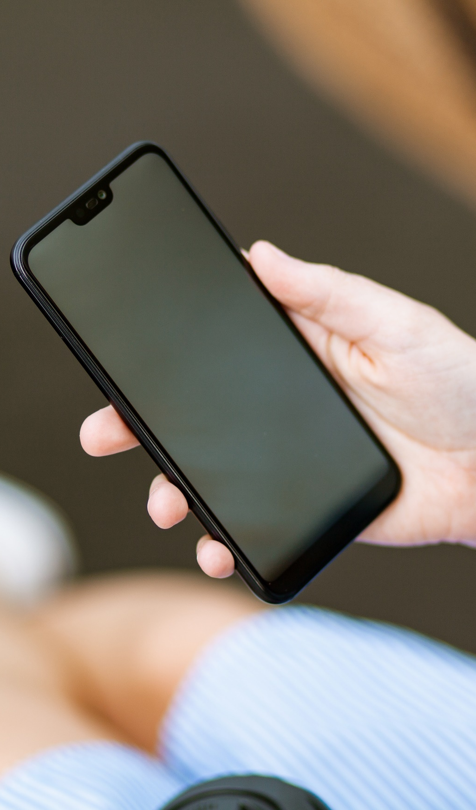
Takeaway
Using IMUs to predict future touches
is feasible.
Not all sensors contribute to good results.
Touch prediction on smartphones will
enhance interaction possibilities.
https://www.pexels.com/photo/person-holding-black-smartphone-1310534/

